Slide 1
BRIGHTBYTES

Slide 2
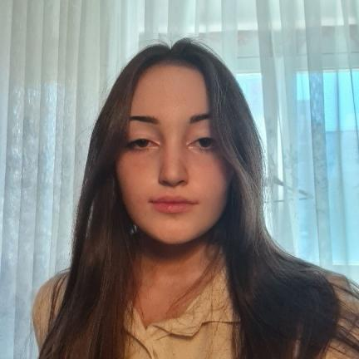
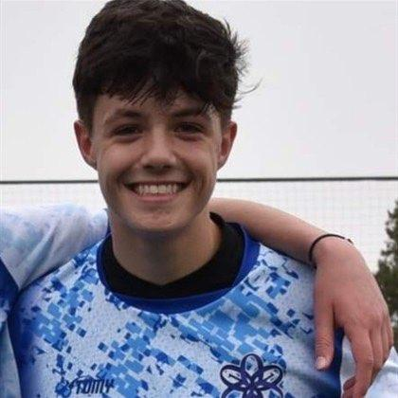
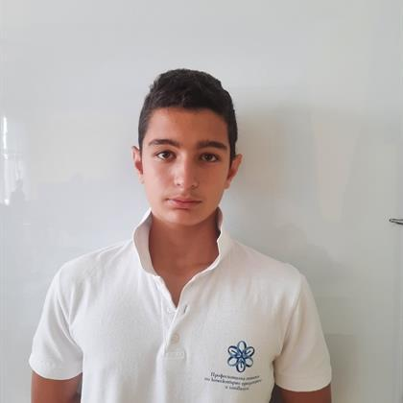
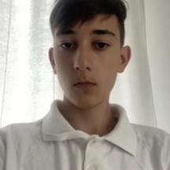
OUR TEAM
Полина Динева 10Г
QA
Стелиян Николов 10Г
Back-end Developer
Теодор Маджаров 10A
Back-end Developer
Кристиян Иванов 10Г
Back-end Developer

Slide 3
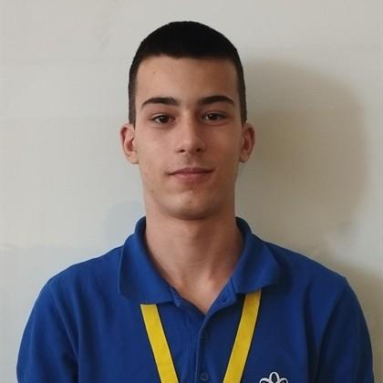
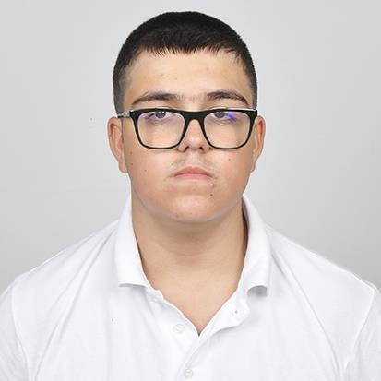
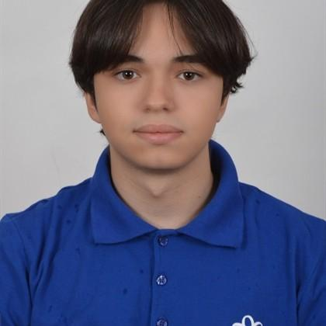
OUR TEAM
Недялко Либчев 9A
Back-end Developer
Виктор Кънев 9А
Scrum Trainer
Михаил Николов 9А
Back-end Developer

Slide 4
The IDEA
The idea of this app is to empower students on their educational journey. An app that not only teaches you but also tests your knowledge, ensuring you grasp every concept with confidence. Say goodbye to traditional textbooks and hello to a smarter, more engaging way to study.

Slide 5
Stages
TASKS AND ORGANIZATION
REALIZATION
TESTS
PRESENT

Slide 6








Used technology

Slide 7
LETS MOVE TO THE APP!

